Slide 1
GMV Optimization for the Brazilian E-commerce company
Dinh Hong Ha – November 2021

Slide 2
Table of contents
Introduction
Data exploration
Business problems and key findings from data
Conclusion and suggestion

Slide 3
Introduction
In this assignment, we face the data come from a Brazilian ecommerce public dataset of orders made at Olist Store. The dataset has information of 100k orders from 2016 to 2018 made at multiple marketplaces in Brazil.
And the main purposes are:
Data Exploration: Explore, clean (if necessary) and describe the dataset
Main strategy of the company is to maximize GMV and optimize spending

Slide 4
Data Exploration
In this part, I mainly use python to process input data through steps:
Check for the null values and replace them
Merge all the data into 1 “all in one” table for further analysis
For more specific, we can go to my notebook for deeply understand:
=> After this section, we have a data table with the fields processed to ensure that it does not affect the analysis later

Slide 5
Business problems and key findings from data
In this section, we will focus on how can we optimize GMV (Gross Merchandise Value):

Slide 6
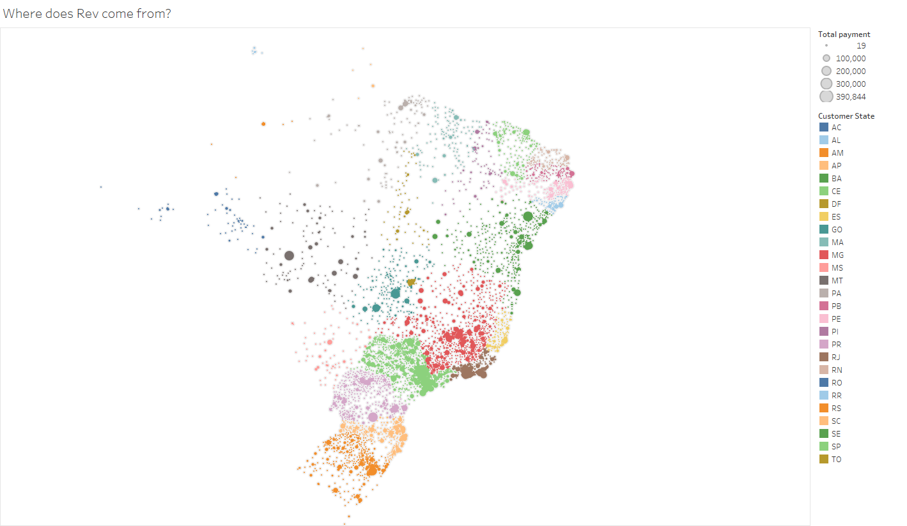
1.Where does revenue come from?
We see that most of the revenue came from the Southeast and South regions of Brazil. It is also possible to see those large cities and capitals, where population is bigger, have larger participation on revenue

Slide 7
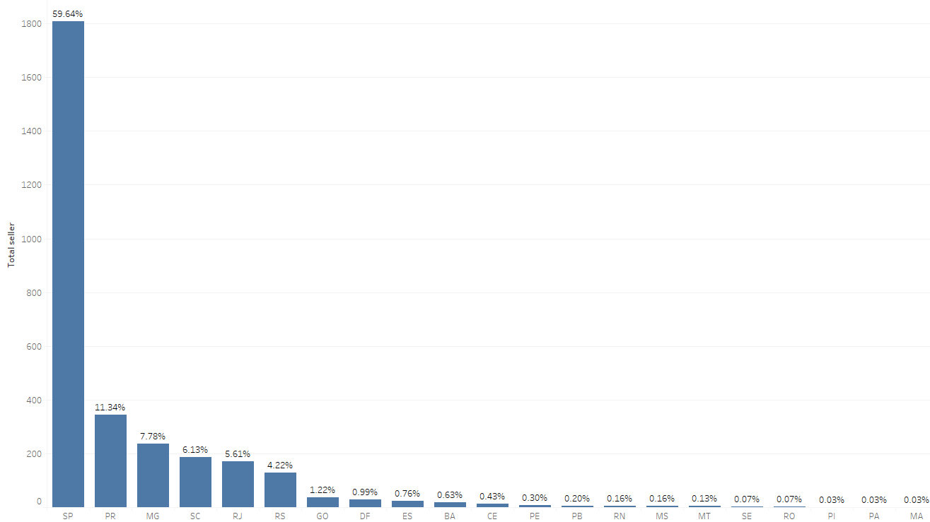
2. Seller through Country
For retailers, it can be seen that they are concentrated mainly in the capitals of the states, and concentrated in 6 major states (~94% of the total number of sellers in the system)
This makes the shipping fee queues will be higher as well as longer waiting times for customers in other regions
Possibly diversify sellers to help connect local customers to local sellers

Slide 8
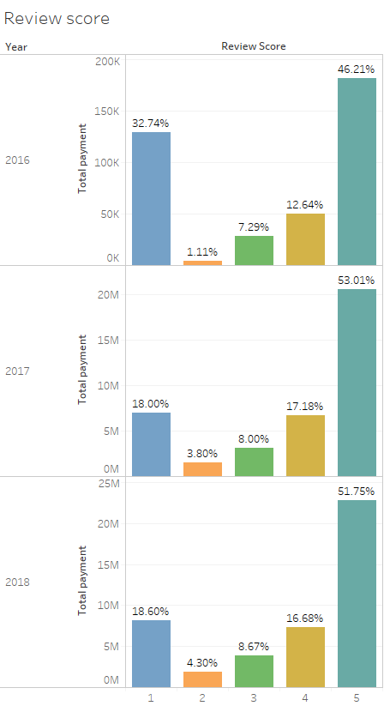
3. Are revenue base on review?
Nearly 70% revenue come from Products with >= 4 score, and this trend keep stable through 2016 to 2018
It’s not a good sign that 18% of revenue come from products with only 1 star
=> The company should focus on top products category with the most revenue and high recommendation by customer

Slide 9
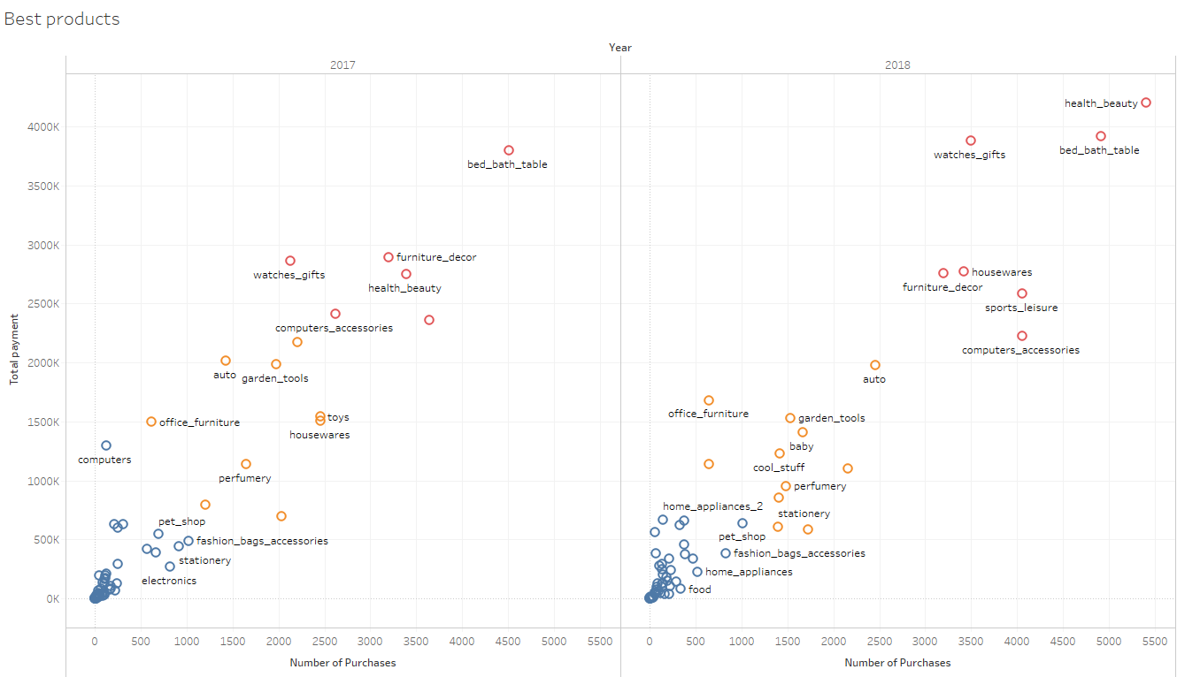
4. What is the best group of products?
We see that the red group is the group that brings the most sales and purchases. It can be seen that the product groups of home appliances, beauty and sports are the administrative aspects that are favored by customers. This group has been quite stable over the past 2 years with sales and purchases always at the top
=> Maintain the sale of these items to ensure revenue
Followed by the yellow group, which includes most of the ancillary products such as garden supplies, toys, perfumes, etc. Compared to 2017, the gap of this group compared to the top products has been widened. larger
=> Need to have promotional stimulus packages to increase output
With the blue group are the top products that contribute the least in the company's revenue. It is necessary to optimize the products in this group by a number of options:
- Remove the group with low rating (<= 2) due to the product being both poor quality and unsold
- For products with good reviews (>=4), these are good products but not many customers have access to them. Some policies can be applied to introduce those products to consumers

Slide 10
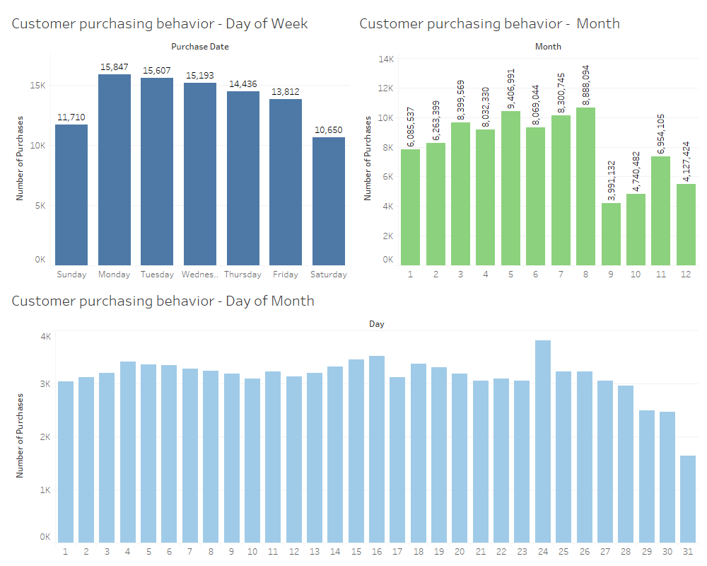
5. Customer Purchasing time:
Base one the Order date, we can see customers usually place orders on weekdays and decrease until the weekend
We also see only a few days of months have a rise of number of purchasing. In addition, customers' demand is high from May to August
=> The company needs to prepare some special events to boost shopping demand in the welcome months and year-end months – the time when shopping should be promoted

Slide 11
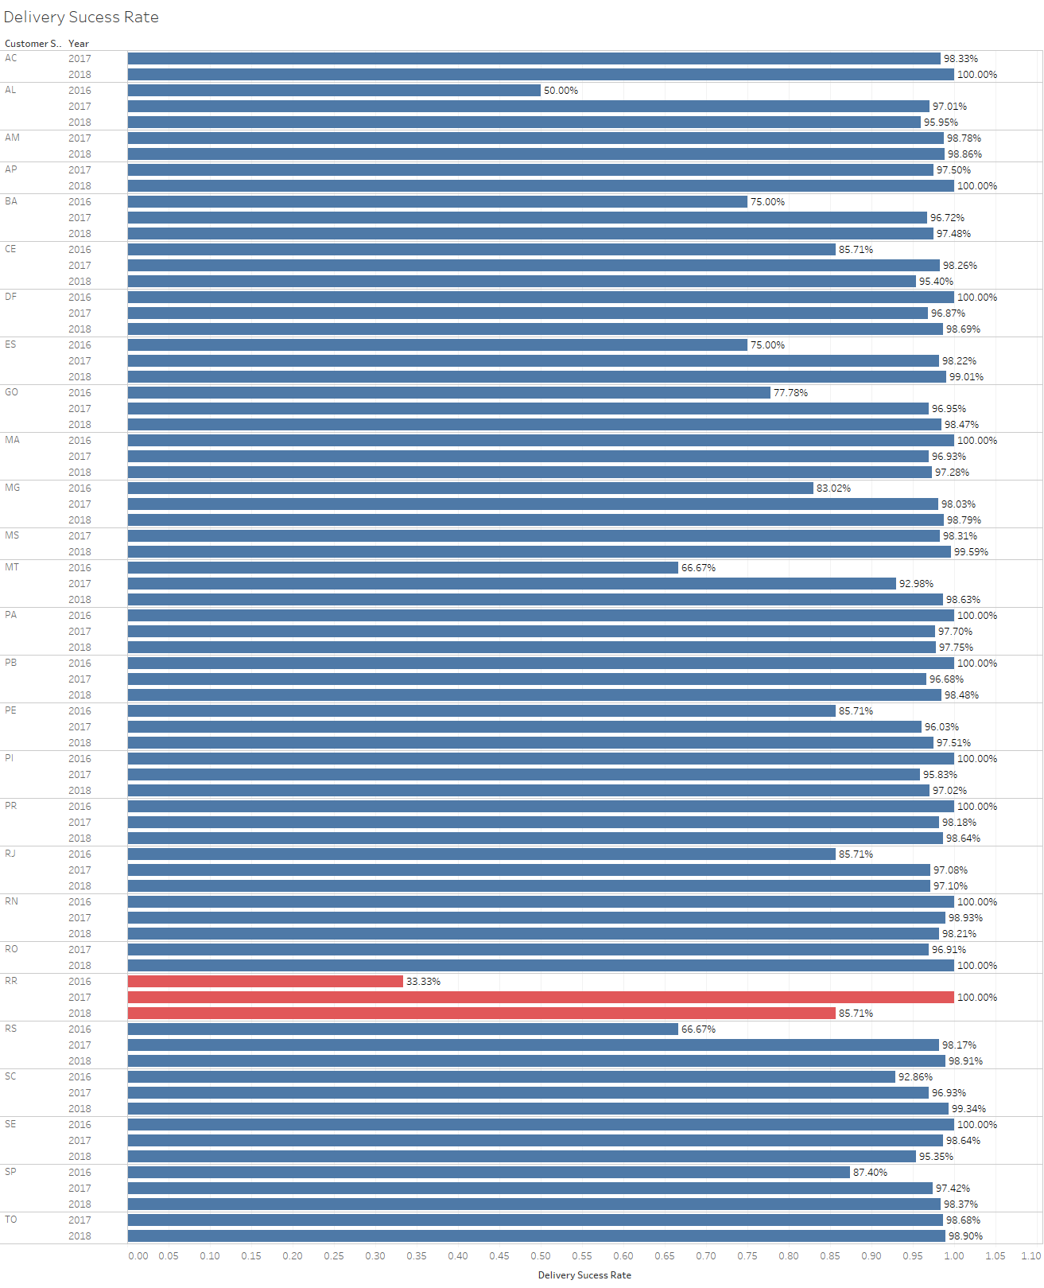
6. Delivery Success Rate
With the shipping rate over the years, we have recorded a good trend with the shipping rate to customers both increasing and reaching an average in 2018 of ~97%
Particularly for state RR, the shipping rate in 2018 decreased compared to 2017 and was only 86%
=> It is necessary to ensure that the delivery of products to RR is more efficient.

Slide 12
Conclusion and Suggestion
With a number of analytical assessments as above, I suggest a number of directions to optimize the company's revenue as follows:
- Distributing sellers in many areas to increase sales to customers in the northern and central regions - Where there are not many sales as well as retailers
- Focus sales campaigns on products that bring stable revenue and good reviews from customers, eliminate poor quality products and low revenue
- There are shopping stimulus campaigns in line with consumers' shopping habits
- Ensure the ability to transport goods better (diversification of retailers also helps to reduce distance and shipping time) especially in state RR

Slide 13
Conclusion and Suggestion
To further optimize the revenue, additionally, the selection of potential customers can be applied through the evaluation of the RFM index.
Having more customer demographic data also makes it easier for the company to identify the right audience for each product group.
In addition, the company should collect more data about the types of offers (discounts, product giveaways) to optimize sales stimulus programs.

